Slide 1
System start – finish for skiing
Student NU «LP»
Zhuk Peter

Slide 2
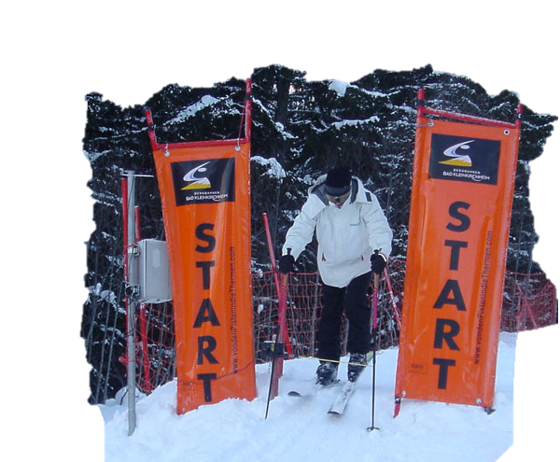
This electron - optical system while fixing the athlete at the start and at the moment of crossing the ultimate party-distance mark. Time starters instantly recorded at the time of exit from the installation of the "Start". "Finish" is recorded with a digital camera, a timer device records the time to within a thousandth of a unit.

Slide 3
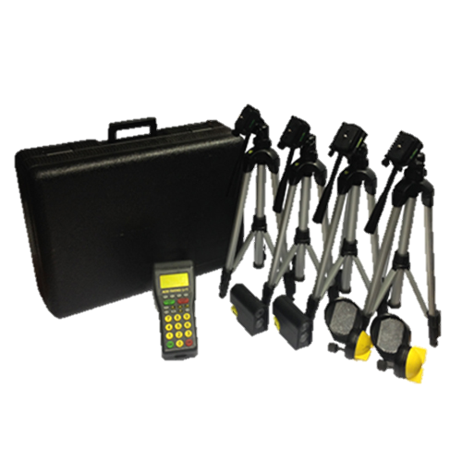
Existing systems:
- іnfrared photocell
- photofinish
- the starting gate for skiers
- RFID tags
іnfrared photocell system

Slide 4
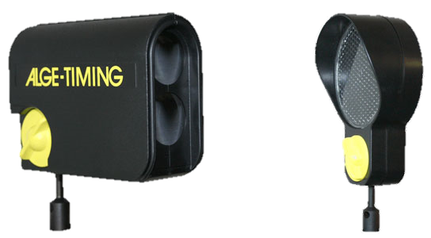
Infrared photocell
Operating principle:
Transmitting target sends a modulated infrared beam. The receiver monitors the target beam and generates a pulse every time the ceiling beam.
Specifications :
- The distance between the target and the reflector: from 0.5 to 25 meters
- The distance between the transmitter and the receiver shots on up to 150 meters
- Response time: 1/10000 to
- Adjusting the delay time from 20 ms to 2 s
- Display settings target IR with LEDs
- Dimensions: 118 x 87 x 44 mm
- Weight: 0.3 kg

Slide 5
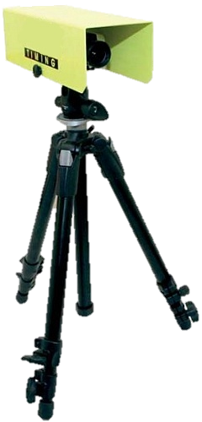
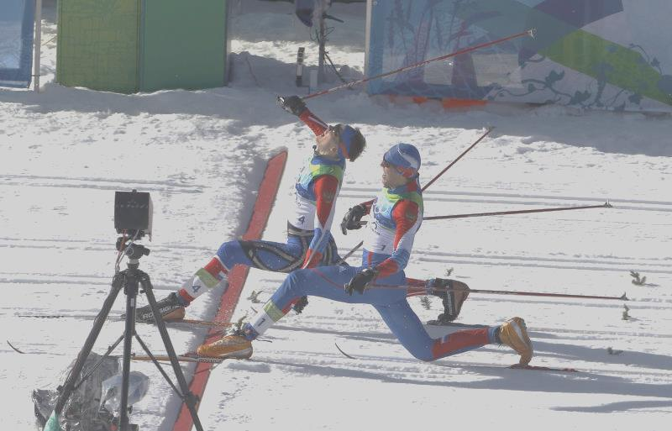
Photofinish
Modern digital photo finish system is comprised of at least one special digital camera using the principle of the so-called shooting slit. The matrix of this digital camera, unlike conventional cameras, to shoot uses only one vertical row of pixels. At the same time the imaging speed can be up to 10,000 lines per second, while the most common systems are up to 2000 scanning lines per second. Most photo-finish cameras have a built-in timer or combined - in this case in the preparation of the image for each line added time marker.

Slide 6
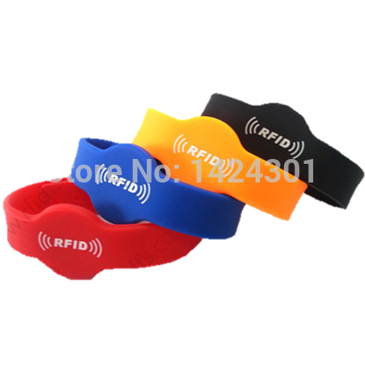
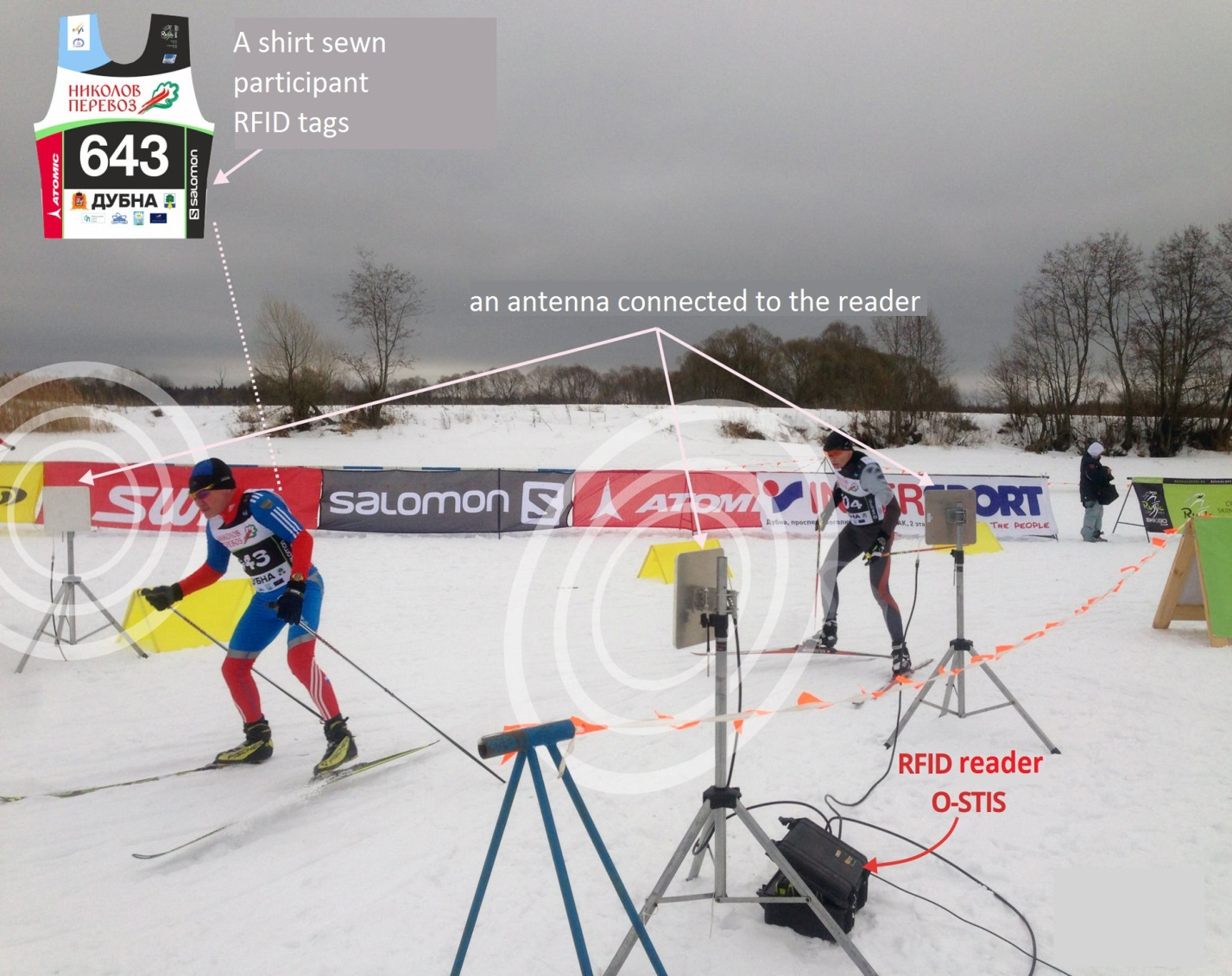
RFID tags
On the object you want to control the RF tag set. When you hit an object with a tag reader in the action zone, the reader receives from the tag information contained therein about the object and sends it to the computing device.

Slide 7
My version of the system

Slide 8
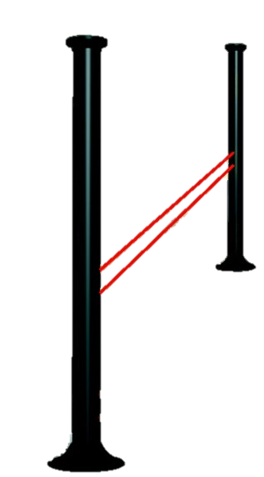
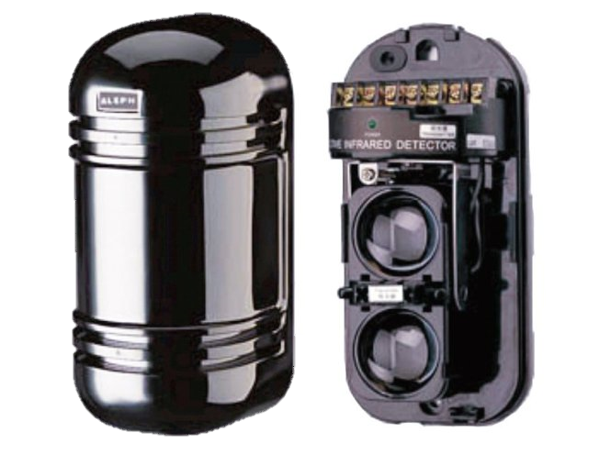
Two towers between which is an infrared barrier
as receiver-transmitter can use ready IR- barriers
such as these pictured
below :
Options | Activa-2
Rated voltage ± 15% | 12 V DC current
Consumption current | 55 mA
Operating temperature range | -25 - + 55 ° C
Range (adjustable) | 10/20 m
The length of the IR radiation | 950 nm
housing height | 52 mm

Slide 9
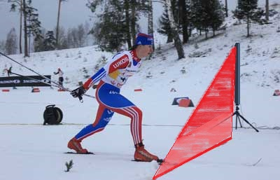
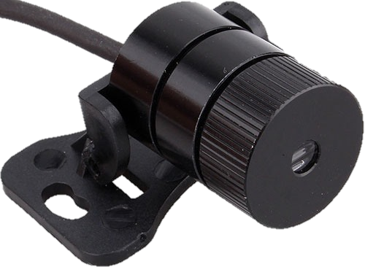
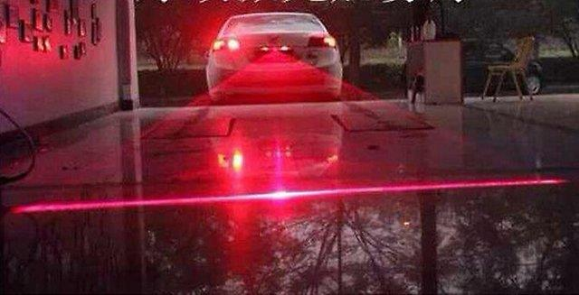
For cars and bicycles have long used laser lights,
which are clearly
visible in any weather.
I propose its use
for skiers.

Slide 10
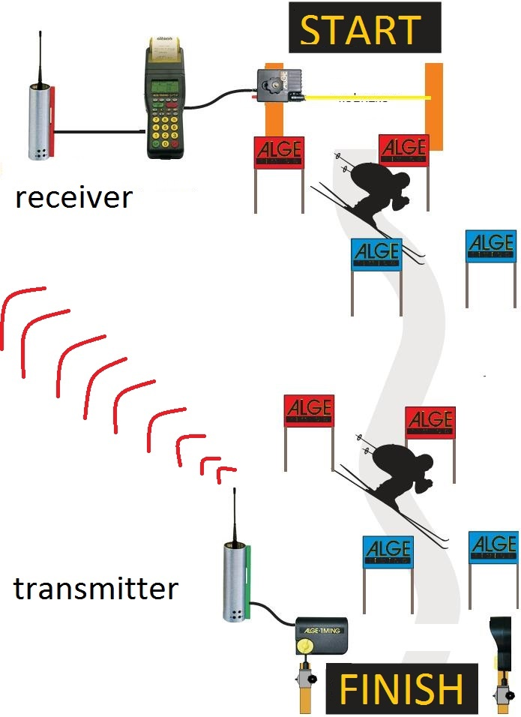
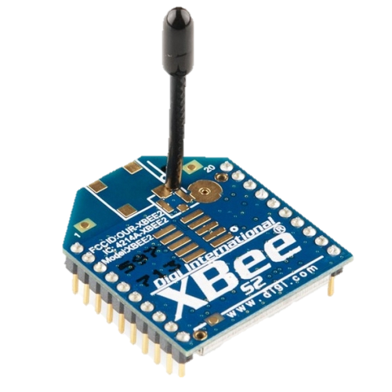
As a receiver and transmitter
can also use ready modules,
which you can choose based
on the desired range of
the system start-finish.

Slide 11
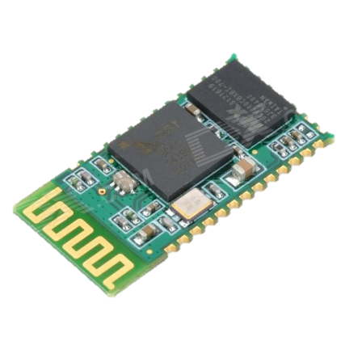
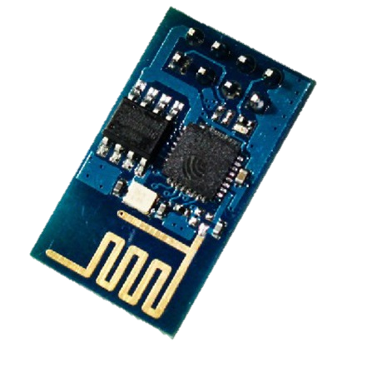


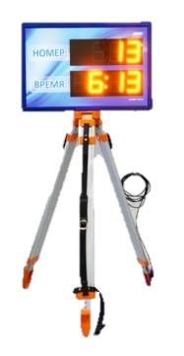
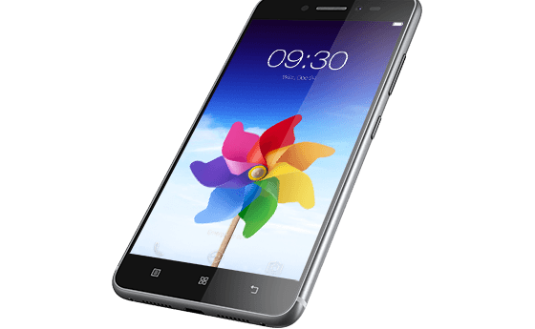
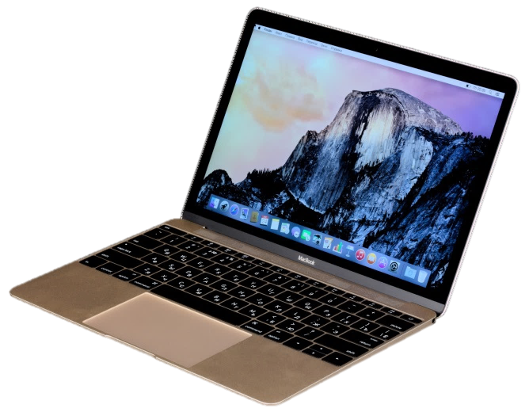
Athlete on your smartphone via bluetooth and wi-fi could send the
check results (you can create a board that will read through the wi-fi and
output the results of the race).

Slide 12
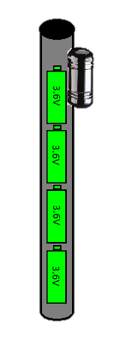
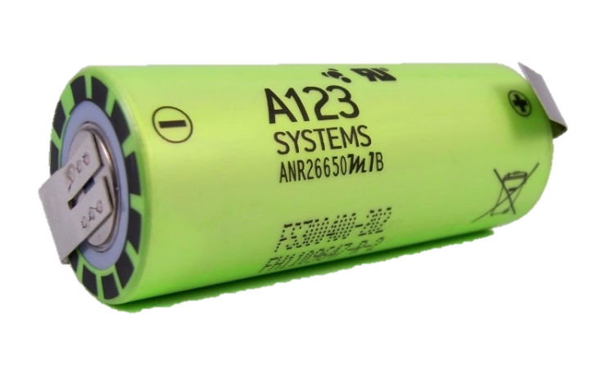
Power
As the power source system, I suggest using a cast-iron-phosphate batteries, as they have several advantages:
+ Do not fear the cold;
+ Is not a fire hazard;
+ Give currents of up to 50 C;
+ Can be charged with high current for 15 minutes;?
+ Have a huge number of charge-discharge cycles (2000-8000 before losing 20% of capacity);
+ Virtually no capacity loss during storage.

Slide 13
The end
Thank you for attention

